Slide 1
Data Handling And Visualization Sample Job-1
-Vansh. Gandhi

Slide 2
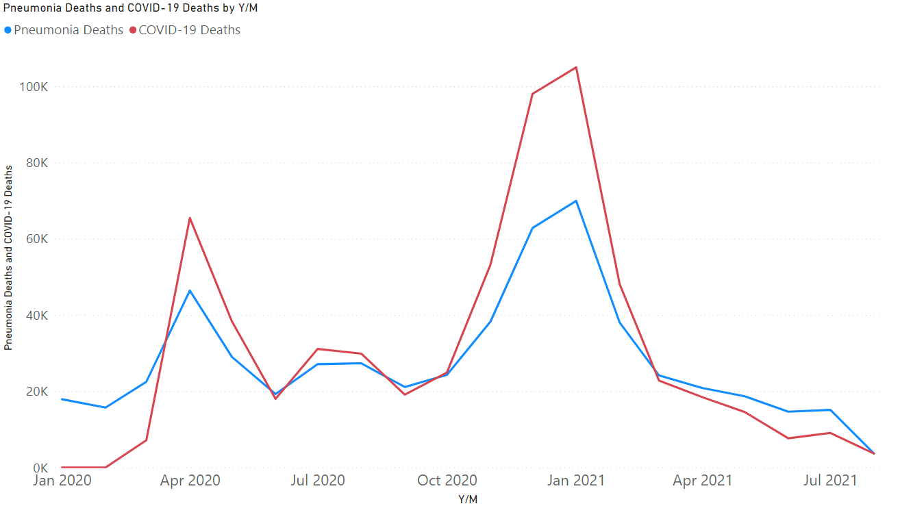
A Line Chart of Deaths due to Covid -19 vs Deaths due to Pneumonia

Slide 3
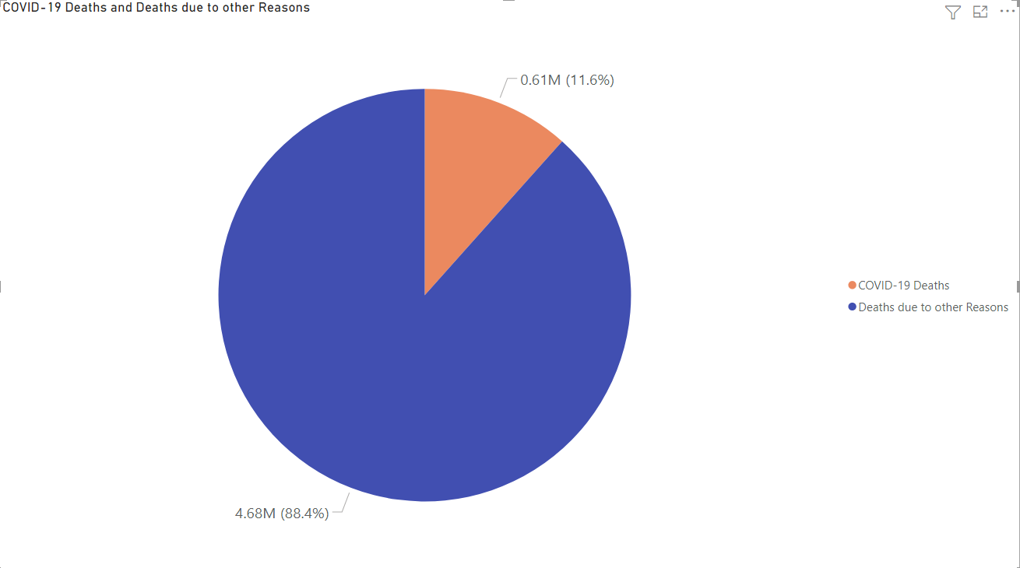
A Pie Chart of Deaths due to Covid – 19 vs Deaths due to Other Reasons

Slide 4
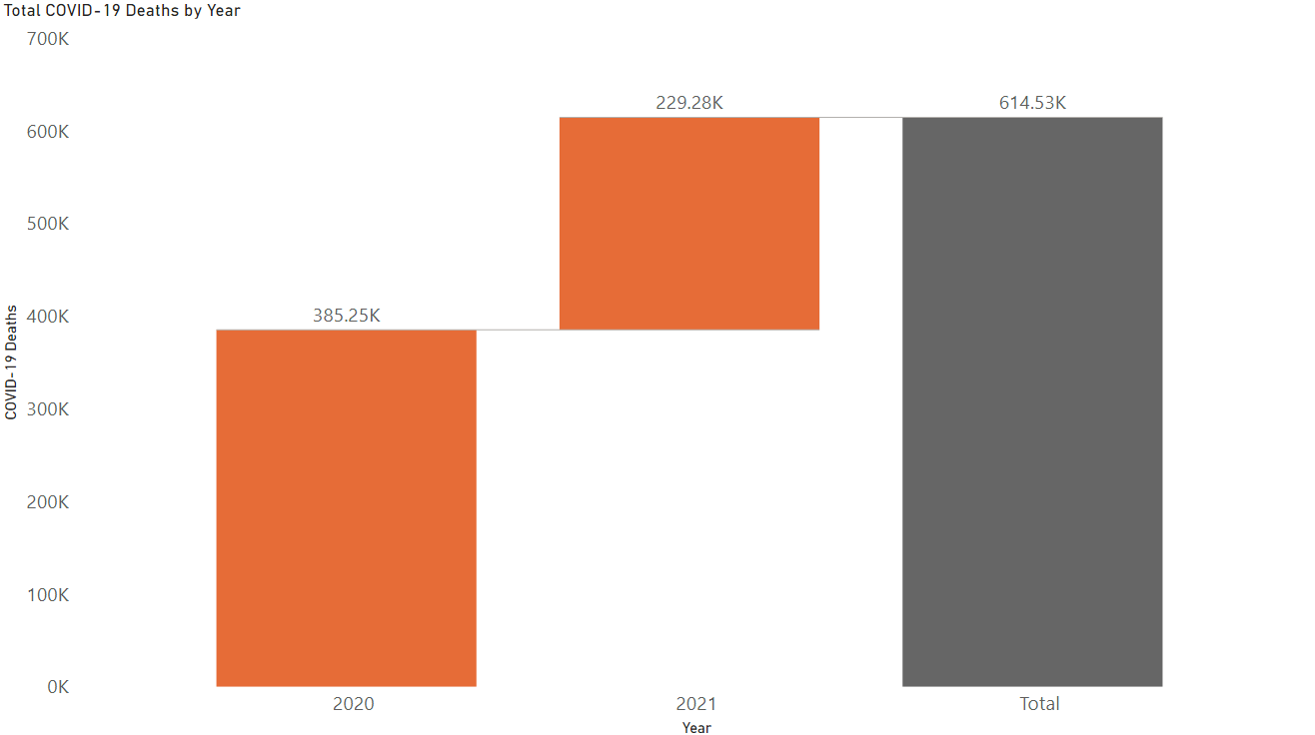
A Waterfall Chart of Total deaths due to Covid 19 in 2020 and 2021

Slide 5
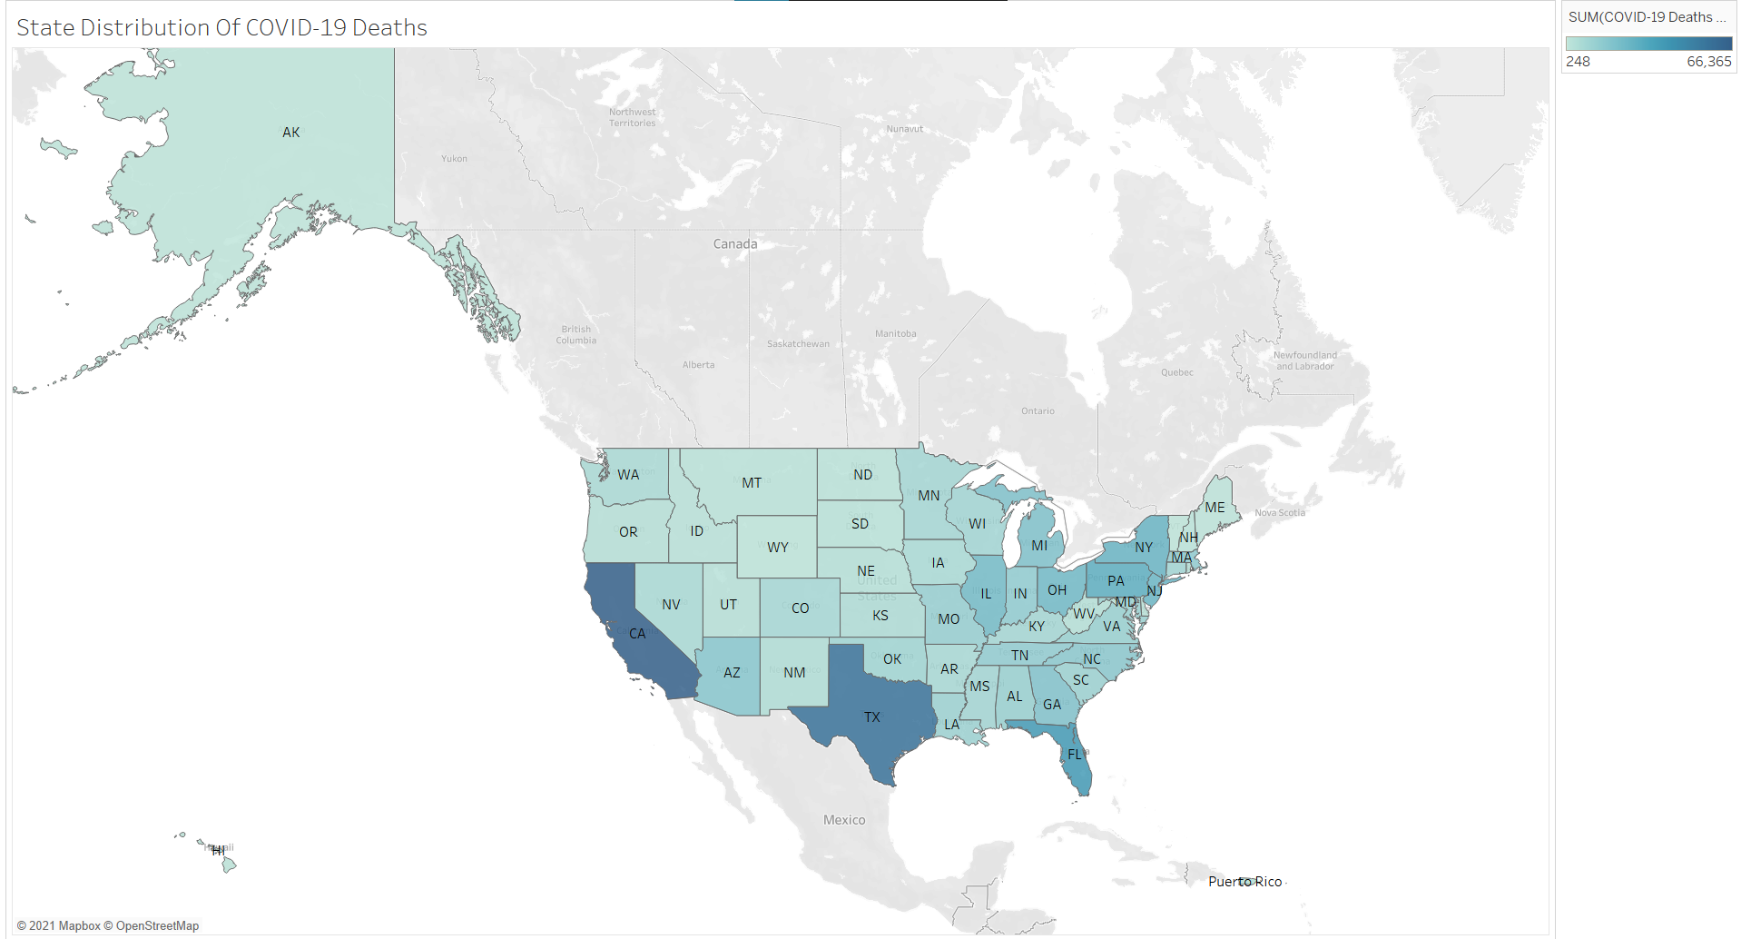
Filled Map of State wise distribution of Covid - 19 deaths in the U.S.

Slide 6
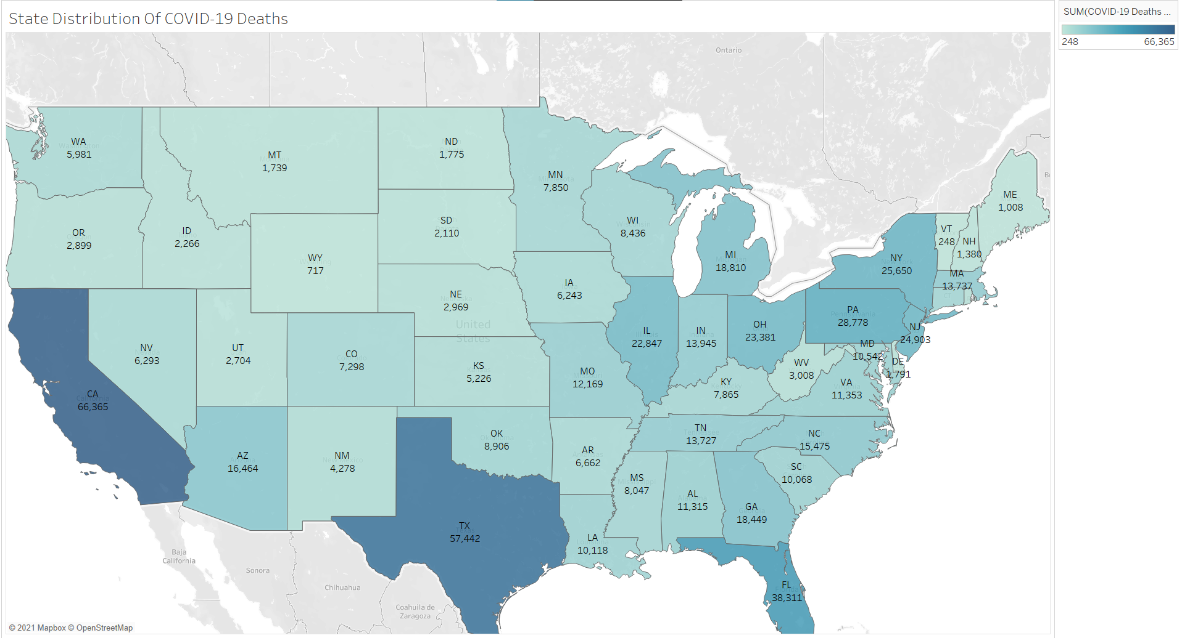
Continue with Numbers

Slide 7
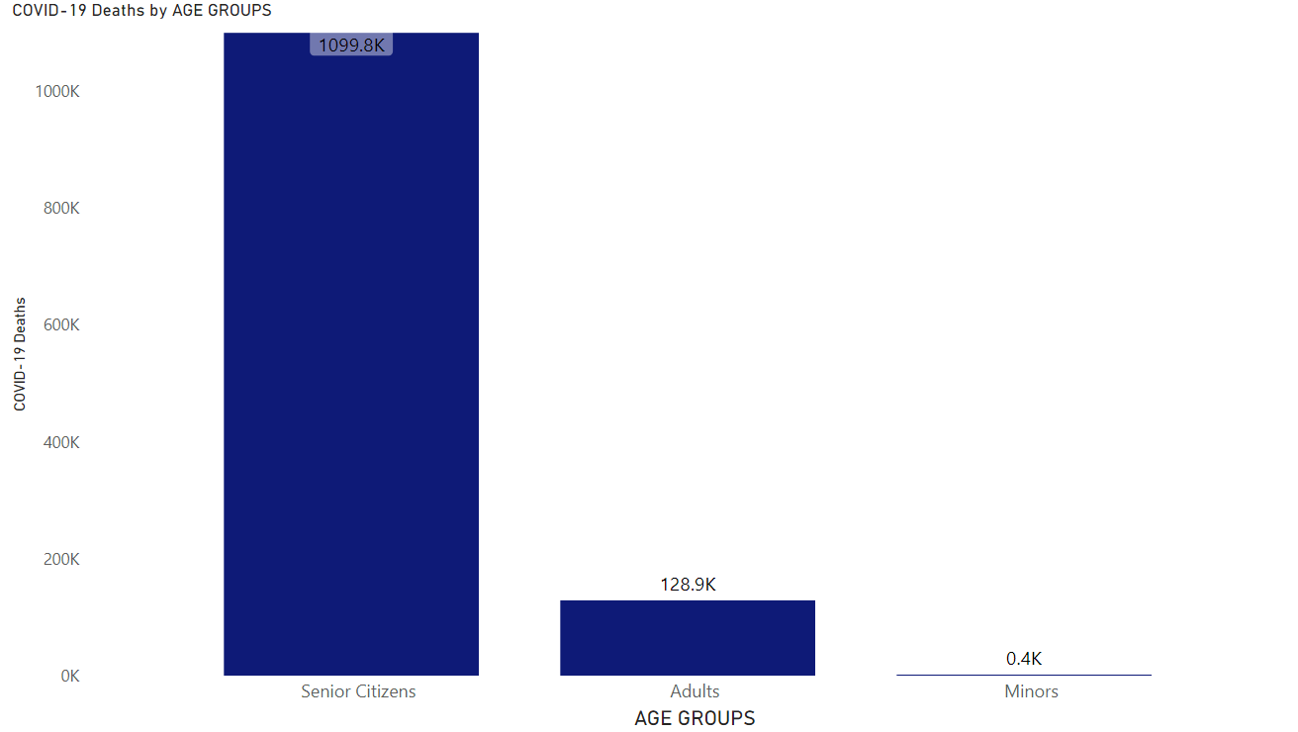
A Stacked Column chart depicting Covid – 19 deaths vs Different Age Groups

Slide 8
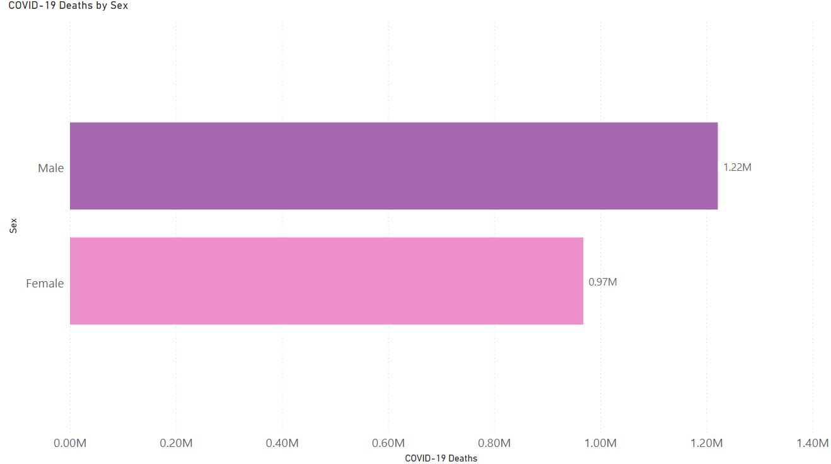
A stacked bar chart depicting Covid – 19 deaths in Males vs Females

Slide 9
THANK YOU

